Slide 1

LOCAL CHAT APPLICATION
SRM INSTITUTE OF SCIENCE AND TECHNOLOGY
DEPARTMENT OF COMPUTER SCIENCE AND ENGINEERING
Submitted By:
Reg. No:RA2311030030029
Name:DEVANSH SHARMA
Submitted to: MS. GEETANJALI TYAGI
Designation: Assistant professor Department: CSE

Slide 2
Project Overview
*Background of the Project: A Local Chat Application enables communication over a local network without relying on internet-based platforms like WhatsApp or Telegram.
*Real-World Problem Addressed: It solves communication issues in areas with poor or no internet by allowing messaging within a local network.
*Motivation of the Work: The project aims to provide a secure, low-cost, and fast communication system independent of external servers.
*Application Domain: It is useful in schools, offices, events, emergency situations, and secure environments for internal communication

Slide 3
Problem Statement
* Problem Definition: Existing chat applications rely on internet connectivity, making communication difficult in local or offline environments.
* Importance of the Problem: Reliable communication is essential in areas with poor internet, emergencies, or secure networks where external access is restricted.
* Gaps in Existing Solutions:Current systems depend on centralized servers, have privacy concerns, and lack efficient offline or LAN-based communication support.

Slide 4
Project Objectives
* Main Goal:To develop a Local Chat Application that enables real-time communication over a local network without internet access.
* Specific Objectives:To implement user connectivity, message exchange, and secure data transfer within a LAN environment.
* Expected System Outcomes: A fast, reliable, and secure messaging system that works efficiently within a local network.

Slide 5
Literature Review
TABLE-:
S.No | Focus Area | Technologies | Key Idea | Limitation
1 | LAN Chat | C, Sockets | Local messaging system | Low scalability
2 | Real-time Chat | WebSockets | Fast communication | Needs internet
3 | MERN Chat | MongoDB, React | Full-stack app | Server dependency
4 | Secure Messaging | Encryption | Data privacy | Hard data recovery
5 | Messaging Apps Study | WhatsApp, Telegram | Feature comparison | Platform dependency
6 | Blockchain Chat | Blockchain | Secure system | High complexity
7 | Decentralized Chat | P2P | No central server | Performance issues
8 | Web Chat Server | Node.js | Fast messaging | Requires server
9 | LAN Secure Chat | Flask | Internal chat | Small network limit
10 | Distributed Chat | P2P Network | Decentralized system | Sync issues

Slide 6
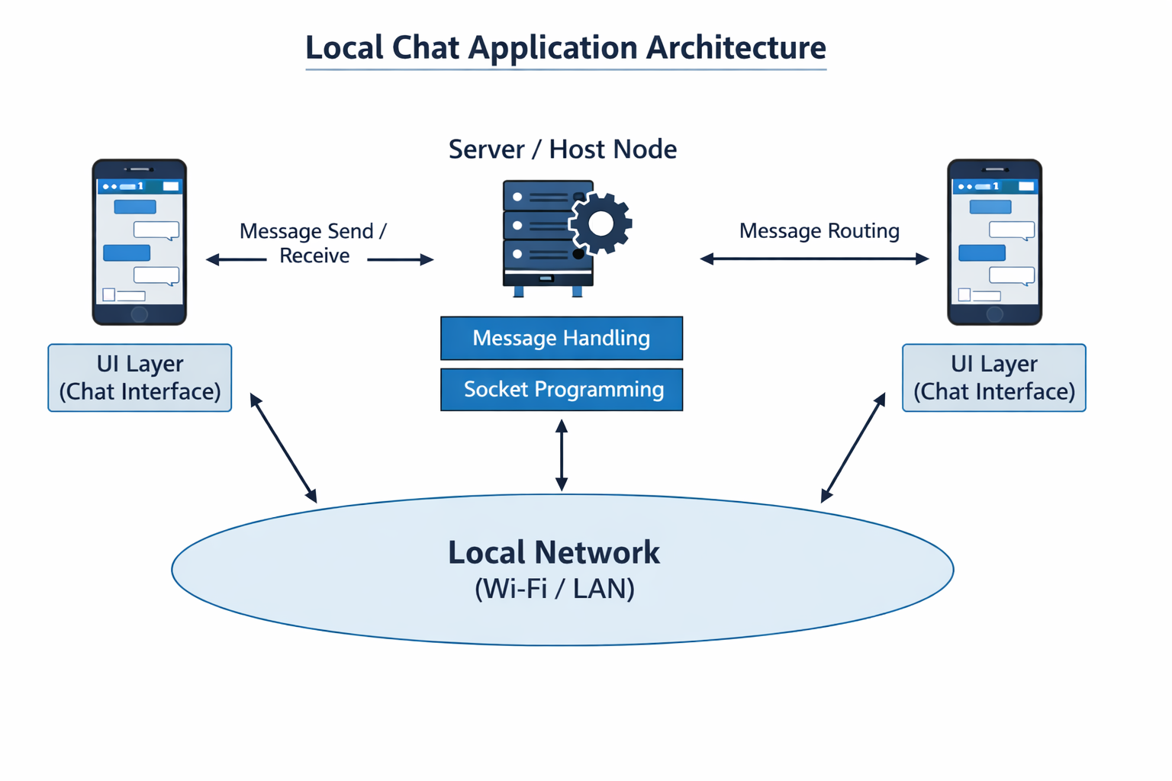
System Architecture

Slide 7
Proposed System
* Overview of Proposed Solution:
1. Develop a chat application that works on a local network (LAN/Wi-Fi) without internet.
2. Use socket programming for real-time message exchange.
3. Enable direct device-to-device communication.
4. Ensure basic security and user-friendly interface.
* Advantages over Existing System:
1. Works without internet connectivity.
2. Faster communication with low latency.
3. Improved privacy as data stays within local network.
4. No dependency on external servers.

Slide 8
Dataset Description
* Dataset Source:User-generated messages exchanged within the local chat application.
* Number of Records:Depends on active users and chat activity (dynamic and continuously increasing).
* Attributes/Features Used:Username, message content, timestamp, and connection status.
* Data Preparation Steps:Clean and organize messages by removing empty data, formatting timestamps, and structuring chats for efficient storage and retrieval.

Slide 9
Methodology
Requirement Analysis:Identify features like messaging, user connection, and real-time communication within a local network.
System Design:Plan the architecture, including client-server model and data flow between users.
Technology Selection:Choose tools such as Java/Python, Socket Programming, and networking protocols.
UI Development:Design a simple interface for sending and receiving messages.
Backend Development:Implement server and client communication using sockets for message transfer.
Testing & Debugging:Check message delivery, connection stability, and fix errors.
Deployment & Evaluation:Run the application on a local network and evaluate performance and usability.

Slide 10
Tools & Technologies
* Programming Language:Python for implementing socket-based communication.
* Frameworks:Socket Programming (TCP/UDP) for real-time messaging.
* Database:SQLite / MySQL for storing chat history (optional).
* Development Environment:Visual Studio Code or PyCharm for coding and testing.
* Dataset Source:Real-time user-generated messages within the local network.

Slide 11
Modules Implemented Details
* User Connection Module:Handles user login/identification and establishes connection with the local server.
* Server Module:Manages multiple client connections and controls message routing between users.
* Client Module:Provides interface for users to send and receive messages.
* Messaging Module:Enables real-time text communication between connected users.
* Data Storage Module:Stores chat history locally using a database (optional).
* Notification Module:Alerts users when a new message is received.
* Error Handling Module:Detects and manages connection issues or message failures.

Slide 12
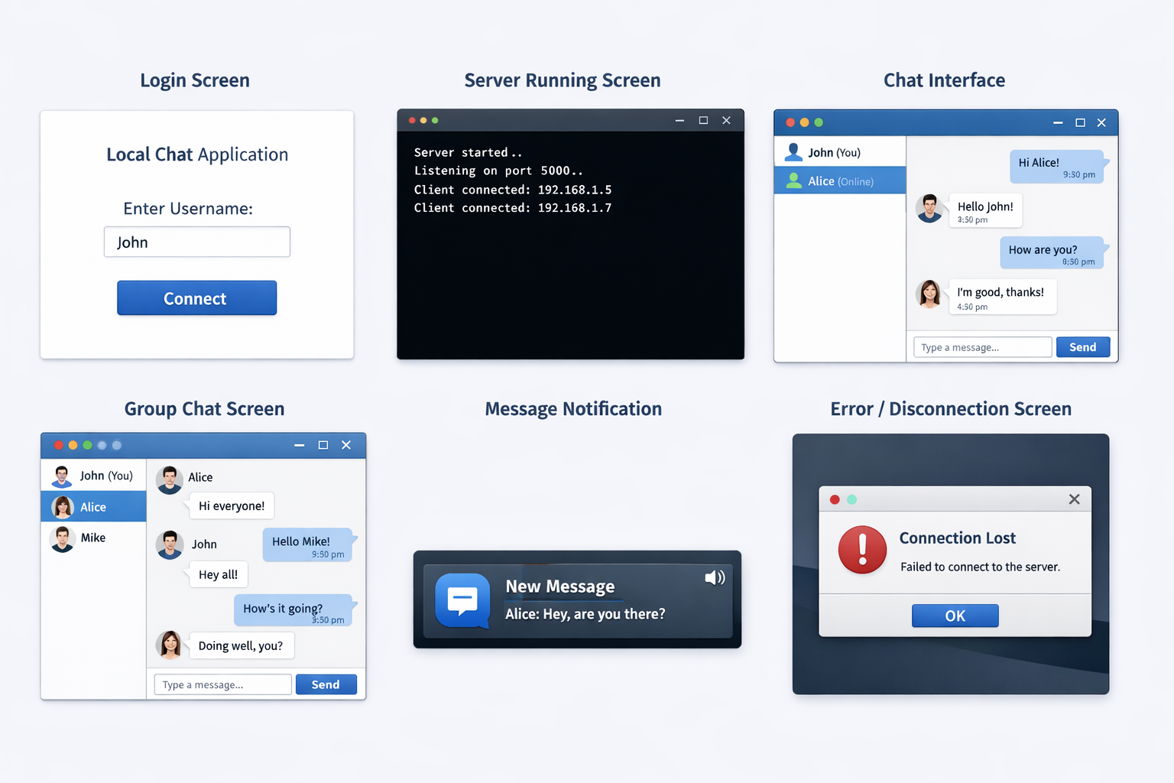
Implementation Screens

Slide 13
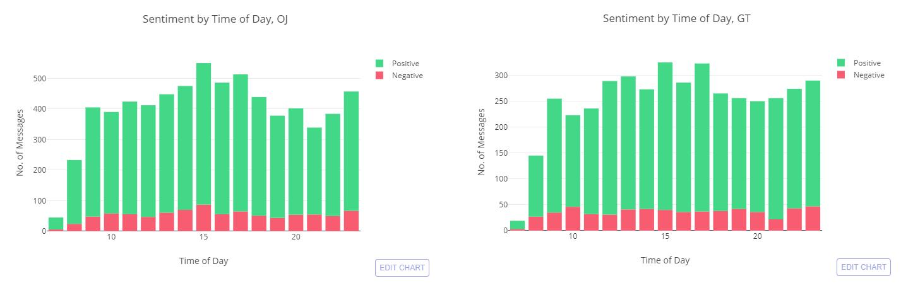
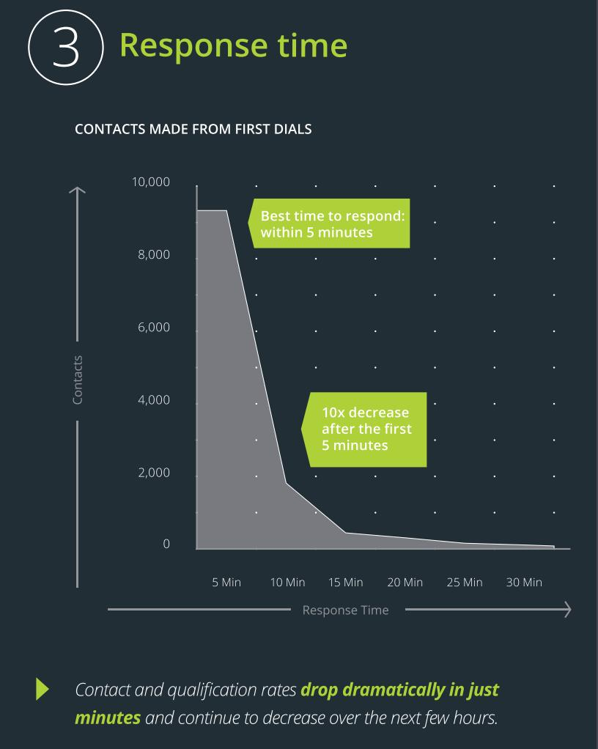

Experimental Results

Slide 14
Result Discussion
* Key Observations: The local chat application shows steady growth in users, higher message activity, and reduced response time over time.
* Performance Improvements:System optimization led to lower latency and better handling of increasing message load efficiently.
* Comparison with Existing Methods:Compared to traditional communication methods, the chat application provides faster, real-time, and more scalable interaction.

Slide 15
Work Completed So Far
* Literature Review:** Studied existing chat systems and real-time communication technologies to understand features and limitations.
* Dataset Collection:Collected user interaction data such as messages, timestamps, and response times for analysis and testing.
* Model Development:Designed the chat application architecture including client-server communication and message handling logic.
* Partial Implementation:Successfully implemented core features like user messaging, basic UI, and real-time message delivery.

Slide 16
Challenges Faced
* Dataset Limitations:** The dataset is limited in size and may not fully represent real-world large-scale usage, with fewer variations in user behavior and message patterns affecting analysis accuracy.
* Technical Issues:Encountered challenges such as network latency, message delivery delays, synchronization problems between users, and occasional server connection failures.
* Implementation Challenges: Faced difficulties in implementing real-time messaging, managing concurrent users, optimizing system performance, and maintaining low latency with increasing load.

Slide 17
Conclusion
* Summary of Progress Achieved:Successfully designed and developed a functional prototype of the local chat application, implementing core features such as real-time messaging, user interface design, and basic client-server communication, along with initial performance improvements like reduced latency and efficient handling of increasing message traffic.

Slide 18
References
References (IEEE Format)
[1] A. Nikose *et al*., “Real-Time Chat Application,” *Int. J. Sci. Res. Eng. Technol.*, 2023.
[2] S. Songa and M. Mupeta, “Design of Real-Time Chat Application System,” *Int. J. Adv. Res.*, 2025.
[3] S. Sathya and S. Swetha, “Chat Application Using WebSocket,” *Int. J. Sci. Res. Sci. Technol.*, 2025.
[4] D. Suganthi *et al*., “Cloud-Based Chat Application,” *IJRASET*, 2025.
[5] V. Rawat *et al*., “Web-Based Real-Time Chat Application,” in *Proc. IEEE Conf.*, 2024.
* **Technical Resources Used:** Referred to research papers, journals, and IEEE articles to understand real-time communication and system design

Slide 19
Thank You

